Slide 1

Project Summary
Porto Seguro’s Safe Driver Prediction
Team22 - Zihan Wan ＆ Rongjing Huang​

Slide 2

Project Introduction​
Porto Seguro Insurance wants to use machine learning models for risk identification to more accurately predict the probability that an insured driver will initiate an auto insurance claim in the following year, thereby adjusting its auto insurance pricing strategy to reduce payout risk and expand its customer market.
This is a competition in Kaggle:
https://www.kaggle.com/competitions/porto-seguro-safe-driver-prediction

Slide 3
Project Goals​
Problem Statement
​
Importance
For insurance companies：
Low accuracy in identifying the risk of customer claims, lack of clarity in the user profile of customers, resulting in large losses in insurance companies' claims, low customer stickiness and difficulty in user acquisition.
For customers：
Solidified or unreasonable pricing of services, resulting in low willingness of customers to enroll or renew their insurance.
For insurance companies：
Based on the model to get the key characteristics of the customer, saving the cost of customer research and facilitating the rapid assessment of the risk of new user claims.
Assessing claim risks based on customer information to provide accurate and reasonable pricing plans can improve customer experience while reducing the company's claim losses, which helps reduce customer churn and develop the customer market.
For customers：
Customers can enjoy customized solutions with reasonable pricing, reduce unnecessary expenses and get more cost-effective service content.

Slide 4
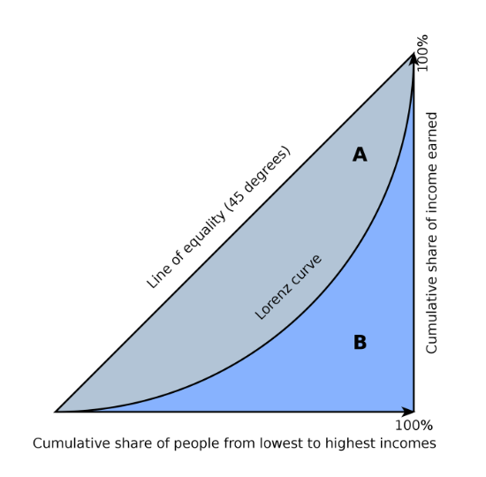
Evaluation Methodology
Scoring Metric
For unbalanced data, where the prediction of a very large magnitude of data in a dichotomous problem leads to dilution of the prediction of a very small magnitude of data, we cannot use traditional accuracy to measure the goodness of the model.
The confusion matrix can measure the prediction accuracy and coverage of the two types of data through precision and recall and f-score respectively, but it cannot be synthesized into one indicator to reflect whether the prediction of the two types of data together is good or bad.
So, the prediction results of the model are evaluated by the Normalized Gini Coefficient.
auc-roc can reflect this result, and it is interconvertible with normalized gini coefficent: Gini = 2 * auc-roc -1

Slide 5
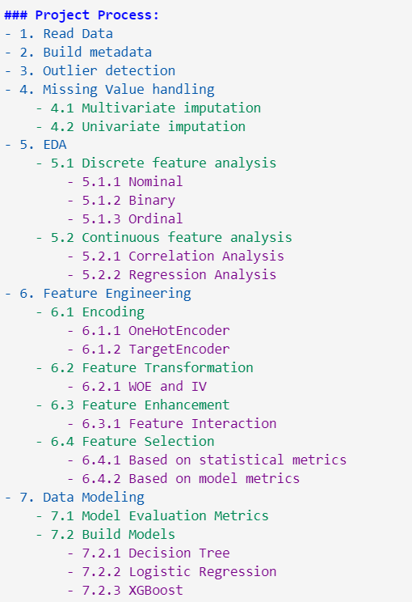
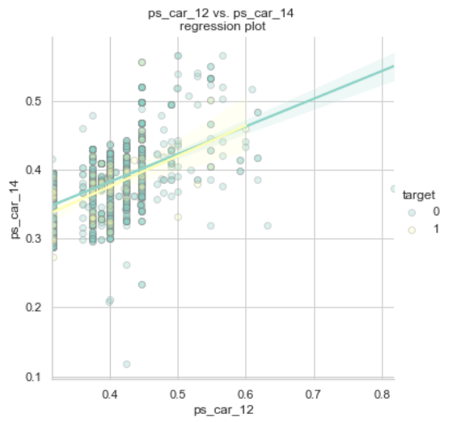
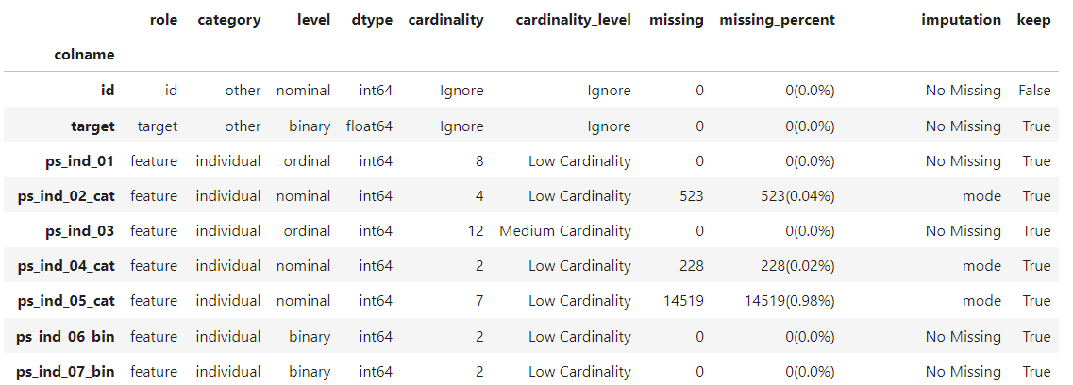
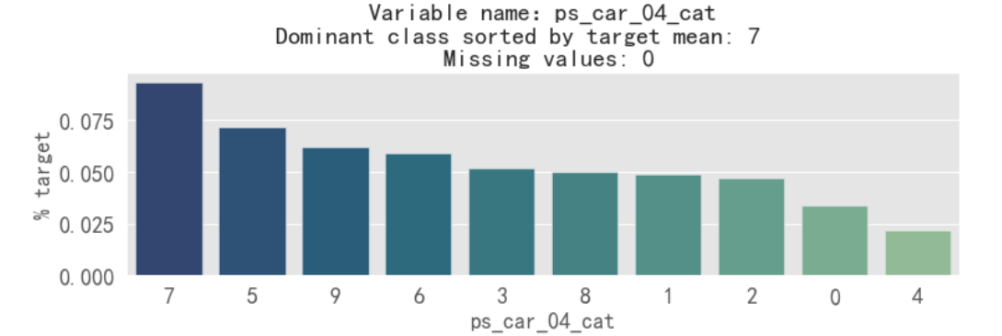
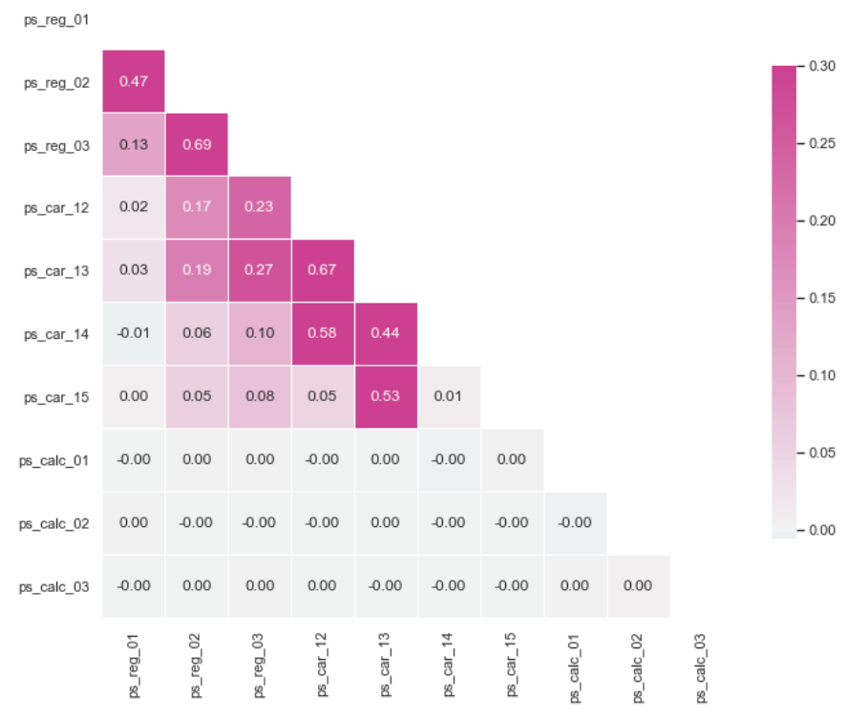
Project Process(1)
Metadata
EDA

Slide 6
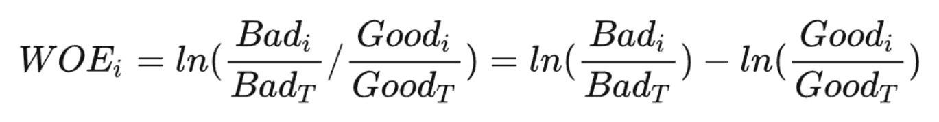
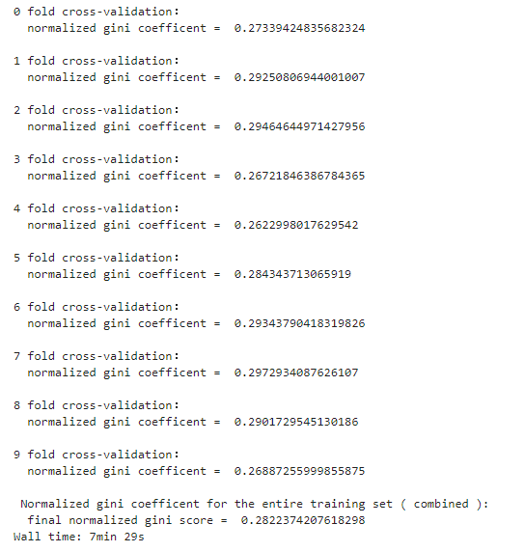
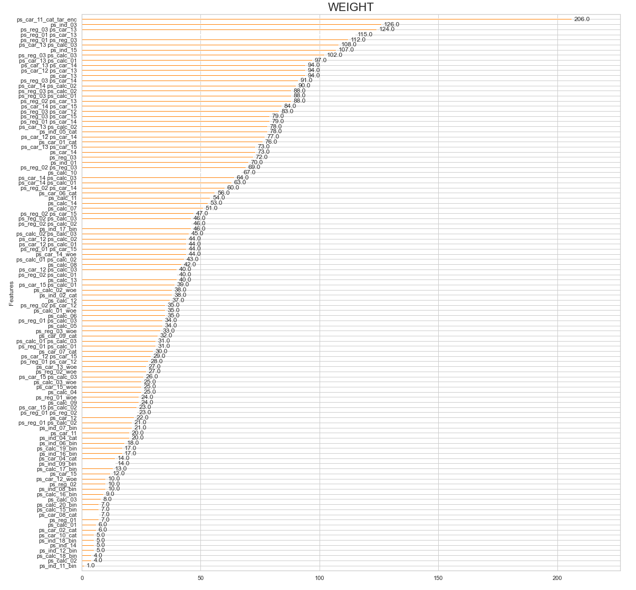
Project Process(2)
Feature Transformation
Data Modeling
Feature Selection
Finally, our model obtained the 0.282 score, which is good given the highest score of 0.296 on kaggle.

Slide 7
THANK YOU

